Slide 1

Recipe Recognition With Deep Learning
PRESENTED BY:
TEAM NO: CSE-007
18UK1A0534 - Muppala Keerthana
18UK1A0556 - Bourishetty Swetha
18UK1A0538- Kaleru Naresh
18UK1A0507 – Bhukya Santhosh

Slide 2
OUTLINE
INTRODUCTION
OBJECTIVE
DATA
MODEL BULDING
DEEP LEARNING ALGORITHM
CONVOLUTIONAL NEURAL NETWORK
SOFTWARE REQUIREMENTS
CONCLUSION

Slide 3
INTRODUCTION
Food is an essential component of our individual and social life. Eating habits have a direct impact on our health and wellbeing, while ingredients, flavour and cooking recipes shape specific cuisines that are part of our personal and collective cultural identities. But there are also interesting applications of automatic food recognition to self-service restaurants and dining halls. For instance, accurate detection and segmentation of the different food items in a food tray can be used for monitoring food intake and nutritional information, and automatic billing to avoid the cashier bottleneck in self-service restaurants. This work deals with the problem of automated recognition of a photographed cooking dish and the subsequent output of the appropriate recipe.In this project, we focus on applications of automatic food recognition and identify the recipe in food by using convolutional neural networks. And this model will classify images into food categories and to output a matching recipe.

Slide 4
OBJECTIVE
Know fundamental concepts and techniques of Convolutional Neural Network.
Gain a broad understanding of image data.
Know how to pre-process/clean the data using different data preprocessing techniques.
Know how to build a web application using Flask framework.

Slide 5
DATA
ML or DL depends heavily on data, without data, it is impossible for a machine to learn. It is the most crucial aspect that makes algorithm training possible. In Machine Learning projects, we need a training data set. It is the actual data set used to train the model for performing various actions.You can collect datasets from different open sources like kaggle.com, data.gov, UCI machine learning repository, etc. As of now, you can download in the next step.

Slide 6
MODEL BUILDING
DEEP LEARNING :
Deep learning is a type of machine learning and artificial intelligence (AI) that imitates the way humans gain certain types of knowledge. ... While traditional machine learning algorithms are linear, deep learning algorithms are stacked in a hierarchy of increasing complexity and abstraction.
Examples:
Convolutional Neural Networks

Slide 7
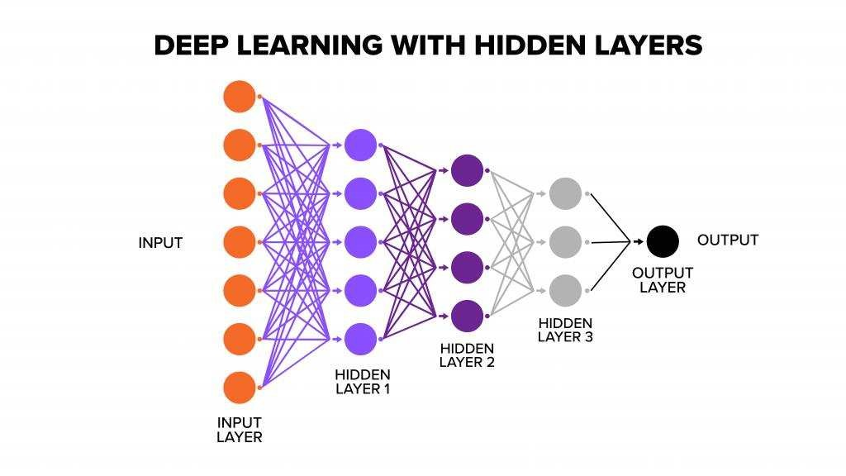
DEEP LEARNING ALGORITHM
Deep learning neural networks, or artificial neural networks, attempts to mimic the human brain through a combination of data inputs, weights, and bias. These elements work together to accurately recognize, classify, and describe objects within the data. Deep neural networks consist of multiple layers of interconnected nodes, each building upon the previous layer to refine and optimize the prediction or categorization. This progression of computations through the network is called forward propagation. The input and output layers of a deep neural network are called visible layers.

Slide 8
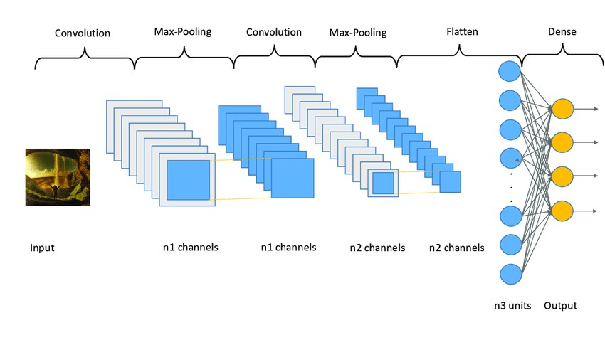
CONVOLUTIONAL NEURAL NETWORK:
A convolutional neural network is a specific kind of neural network with multiple layers. It processes data that has a grid-like arrangement then extracts important features. Convolutional neural networks are based on neuroscience findings. They are made of layers of artificial neurons called nodes. These nodes are functions that calculate the weighted sum of the inputs and return an activation map. This is the convolution part of the neural network.

Slide 9
SOFTWARE REQUIREMENTS
Anaconda navigator
Jupyter notebook
Jupiter spyder
Deep learning Tools: pandas,
NumPy,
Tensor flow,
Keras,

Slide 10
CONCLUSION:
In this project we have presented the Recipe Recognition With Deep Learning
We have done the Prediction using Deep Learning Techniques.
For the better results we applied CNN layers and proved with accuracy.

Slide 11
THANK YOU…

